Slide 1
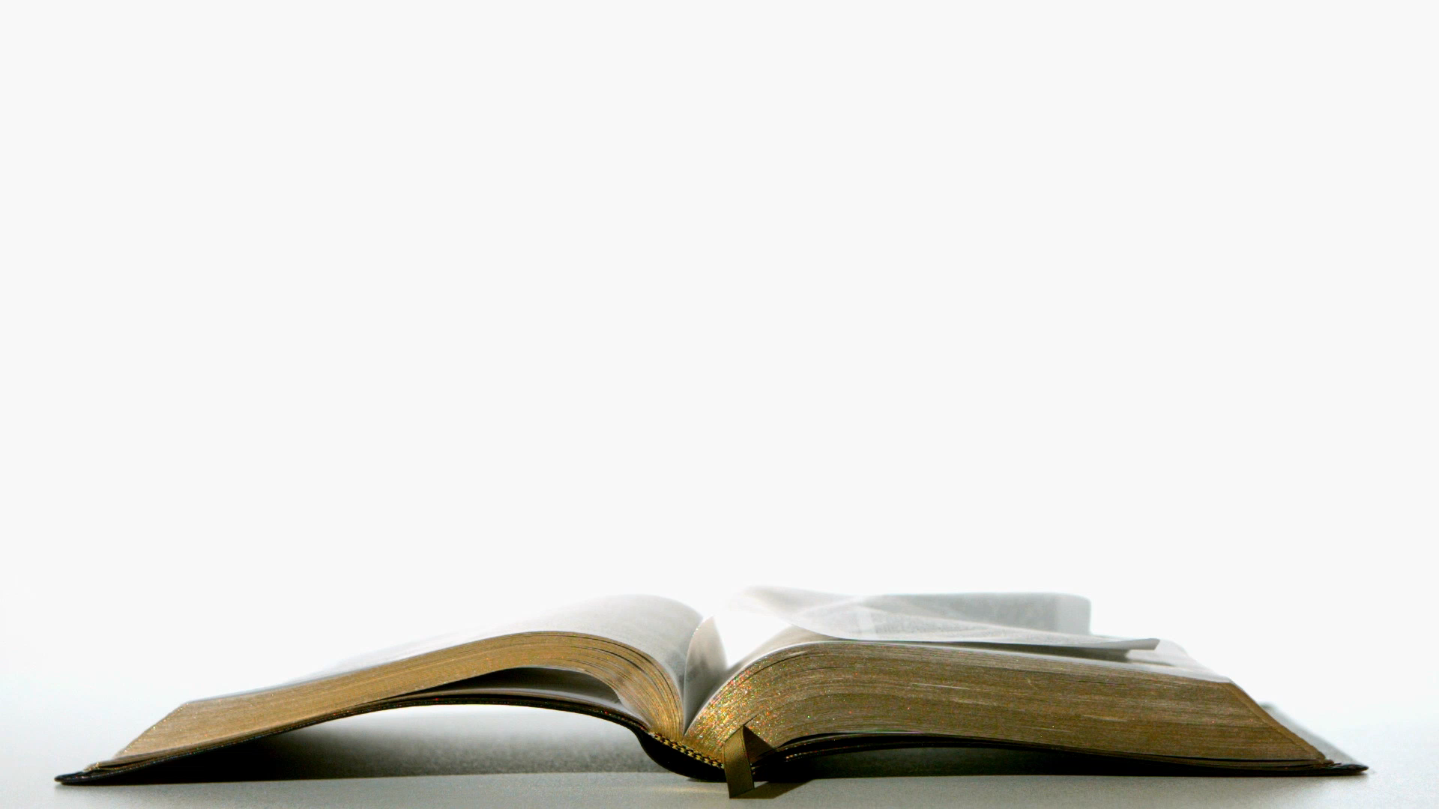
How to Read Literature Like a Professor
Chapters 15,

Slide 2
Ch 15: Flights of Fancy
Flight is a symbol, of course
Humans can’t fly, generally speaking

Slide 3
Meaning that when we see a person suspended in the air, even briefly, he is one or more of the following:
1) a superhero
2) a ski jumper
3) crazy (redundant if also number 2)
4) fictional
5) a circus act, departing a cannon
6) suspended on wires
7) an angel
8) heavily symbolic

Slide 4
Flight in history
Greek literature talks about flight. Check out this story about Icarus: (1) Miscellaneous Myths: Icarus – YouTube
People have been fascinated with flight for most of human history

Slide 5
So what does it mean when literary characters fly?
“Freedom, escape, return home, largeness of spirit, love. That’s a lot for just one work to do with flying. What about others? What about E.T.? When those bicycles leave the street in the Steven Spielberg classic, what’s the situation? The adults of the community, representing conformity, hostility to anything new, xenophobia, suspicion, a lack of imagination, are bearing down on our young heroes. They’ve even set up a roadblock. At just the moment when things look worst, the bicycles leave the earth and, with it, the earthbound grown-ups. Escape? Certainly. Freedom? You bet. Wonder, magic? Absolutely.” (1) Ride in the Sky - E.T.: The Extra-Terrestrial (9/10) Movie CLIP (1982) HD - YouTube

Slide 6
It’s really pretty straightforward: flight is freedom.

Slide 7
Flight: Interrupted
“What about characters who don’t quite fly or whose flights are interrupted? Since Icarus, we’ve had stories of those whose flights end prematurely. In general, this is a bad thing, given what is the opposite of flying.”
“the act of falling from vast heights and surviving is as miraculous, and as symbolically meaningful, as the act of flight itself. As thrilled as we are by the prospect of flying, we are also frightened at the prospect of falling, and anything that seems to defy the inevitability of a plummeting demise sets our imaginations working overtime. The survival of these characters demands that we consider the implications. What does it mean to survive certain death, and how does such survival alter one’s relationship to the world? Do the characters’ responsibilities to themselves, to life itself, change? Is the survivor even the same person any longer?”

Slide 8
“These flights of fancy allow us, as readers, to take off, to let our imaginations take flight. We can sail off with characters, freed of the limitations of our tuition payments and mortgage rates; we can soar into interpretation and speculation. Happy landings.”

Slide 9
Assignment
Pick a story that has flight in it. It might be Sister Raven, “A Very Old Man with Enormous Wings” or even a super-hero movie or story.
Answer this question in the online discussion: How does flight influence the story? What do you think it represents?

Slide 10
Chapter 18: Baptism
“QUICK QUESTION: I’m walking down the road and suddenly I fall into a pond. What happens? I drown? Thanks for the vote of confidence. Or I don’t? That pretty much covers it. Now what does it mean? Does it really mean anything either way? I mean, if you drown, you drown. If you get out, maybe all it means is you can swim. Fair enough. For a character in a novel, though, the case is different. What does it mean if he drowns, or if he doesn’t? Have you ever noticed how often literary characters get wet? Some drown, some merely get drenched, and some bob to the surface. What difference does it make?”

Slide 11
“First of all, let’s take care of the obvious. You can fall into the water in an instant, from a bridge that gives way, for instance, or you can be pushed, pulled, dragged, tripped, or tipped over. All of which have their own meanings, of course, and can be taken quite literally. Beyond that, drowning or not has profound plot implications, as do the means by which a character does or doesn’t drown.”
Basically – getting wet is significant, both how the character gets wet and then what happens after they get wet.

Slide 12
Generally, getting wet means getting a new identity
It’s like baptism – the old self dies and a new one emerges.
What happens to Aladdin after he almost drowns? (1) Genie Saves Aladdin Scene - Aladdin Second Wish Scene | Aladdin 2019 Movie Scene Clip – YouTube
Which part of him dies? Discuss with your classmates.
How about when he is caught in the snow? What part dies then?

Slide 13
My interpretation?
When he almost drowns, he takes that opportunity to try and kill off “Aladdin,” deciding to become Prince Ali. However, this lie does not work out for him and he is re-baptized in snow, where the lie finally dies.

Slide 14
Interpret a drowning/swim/baptism
Take a look at one of the scenes below. Hopefully one of them looks familiar to you. Or, if you have a drowning/swim in mind, you can use that instead. In the discussion post, write which clip you chose and how the character changed after their interaction with water.
Disney almost drowning scenes: (1) top 10 disney channel (almost) drowning scenes – YouTube
Lilo and Stitch: (1) Drowning Scene Lilo and Stitch – YouTube
Ferris Bueller’s Day off (around min 3) (1) Ferris Bueller's Day Off - Cameron goes berserk – YouTube
Captain America (1) Captain America - Plane Crash Scene – YouTube

Slide 15
Chapter 19: Geography
“We readers have to give their decisions [where a story happens] some thought as well. What does it mean to the novel that its landscape is high or low, steep or shallow, flat or sunken? Why did this character die on a mountaintop, that one on the savanna? Why is this poem on the prairie? Why does Auden like limestone so much? What, in other words, does geography mean to a work of literature?
Would ‘everything’ be too much?”

Slide 16
So what’s geography, then? I usually think of hills, creeks, deserts, beaches, degrees latitude.
Stuff: economics, politics, history.
Why didn’t Napoleon conquer Russia? Geography.
Geography influences economics, politics, and history of the story. It can also be symbolic.

Slide 17
Geography in literature can also be more. It can be revelatory of virtually any element in the work. Theme? Sure. Symbol? No problem. Plot? Without a doubt.
Geography can also define or even develop character. (like a character crossing a mountain to overcome some personal obstacle)

Slide 18
General Geography rules
“Okay, so here’s the general rule: whether it’s Italy or Greece or Africa or Malaysia or Vietnam, when writers send characters south, it’s so they can run amok. The effects can be tragic or comic, but they generally follow the same pattern.” (Think of teenagers going to the Florida Keys for spring break.)

Slide 19
More General rules
Hills and valleys have a logic of their own. Why did Jack and Jill go up the hill? Sure, sure, a pail of water, probably orders from a parent. But wasn’t the real reason so Jack could break his crown and Jill come tumbling after? That’s what it usually is in literature. Who’s up and who’s down? Just what do up and down mean? First, think about what there is down low or up high.
Low: swamps, crowds, fog, darkness, fields, heat, unpleasantness, people, life, death.
High: snow, ice, purity, thin air, clear views, isolation, life, death. Some of these, you will notice, appear on both lists, and you can make either environment work for you if you’re a real writer.

Slide 20
So what?
This is why Geography becomes so important. You need a working knowledge of Geography to fully understand literature that takes place outside of a location that you personally know.
Also, so you can understand the news.

Slide 21
Assignment
Use your book (Sister Raven or The Alchemist)
Identify where in the world it is taking place (or approximately, because you may not know an exact location)
Discuss it with your classmates. How does it influence the story?
Create a one-page mini poster about the setting of your story. On the back, write 5 sentences about WHERE the story takes place and how the story would be different if it took place elsewhere, OR how the geography of the story influences it.
This is a PAPER assignment, so you will need to hand it in to Ms. Stacey, or take a picture and email it.

Slide 22
Ch 20: Seasons
By now, you should guess that seasons also factor into what literature means. We’ve already covered weather and geography. We already know that everything is a symbol. It should come as no surprise, then, that the season also factors into the story.
Have you ever seen Home Alone? How would the story be different had it taken place during the summer? (1) Home Alone (1990). Trailer - YouTube

Slide 23
HERE’S MY FAVORITE SNIPPET OF POETRY:
That time of year thou mayst in me behold
When yellow leaves, or none, or few, do hang
Upon those boughs which shake against the cold:
Bare, ruined choirs, where late the sweet birds sang.

Slide 24
“As you know, that’s Shakespeare’s sonnet 73, your constant bedside reading. I like it for a lot of reasons. First, it just sounds wonderful—say it out loud a couple of times and you’ll start to hear how the words play off each other. Then there’s the rhythm. I often recite it in class when I’m explaining meter and scansion—how the stressed and unstressed syllables function in lines of poetry. But the thing that really works here, and in the next ten lines, is the meaning: the speaker is seriously feeling his age here and making us feel it, too, with those boughs shaking in the cold winds, those last faded leaves still hanging, if barely, in the canopy, those empty limbs that formerly were so full of life and song.”

Slide 25
Listen to this: (1) Frank Sinatra - It Was A Very Good Year (Lyrics) - YouTube
Look up the lyrics for this song: It was a Very Good Year by Frank Sinatra
What mentions of seasons are there?
What do the seasons mean?

Slide 26
My interpretation
The summers represent his youth.
Autumn represents him getting older.
Winter = death?
Now look up the lyrics for “September of my Years” by Frank Sinatra. See a pattern?

Slide 27
What else about seasons?
“The Beach Boys made a very lucrative career out of happy-summer-land with all those surfing and cruising songs. Head for the beach with your surfboard and your Chevy convertible in a Michigan January and see what that gets you.”
(1) The Beach Boys ~ Surfin' Safari (1962) - YouTube

Slide 28
“Every writer can make modifications in his or her use of the seasons, and the variation produced keeps seasonal symbolism fresh and interesting. Will she play it straight or use spring ironically? Will summer be warm and rich and liberating or hot and dusty and stifling? Will autumn find us toting up our accomplishments or winding down, arriving at wisdom and peace or being shaken by those November winds? The seasons are always the same in literature and yet always different. What we learn, finally, as readers is that we don’t look for a shorthand in seasonal use— summer means x, winter y minus x—but a set of patterns that can be employed in a host of ways, some of them straightforward, others ironic or subversive. We know those patterns because they have been with us for so long.”

Slide 29
Assignment
Finish reading your book as we are starting a new book next week.
Take a kahoot quiz on your book:
Sister Raven:
The Alchemist: https://kahoot.it/challenge/08724616?challenge-id=a51681fb-de6d-4842-8f7c-389bfb07e427_1612128687641
You can take it twice and I’ll keep the best of the two scores

Slide 30
Usually it means…
Spring is new growth / babies / new life.
Summer is youth, happiness (but it can mean hot and stifling as well)
Fall means growing older / obtaining knowledge / being wise
Winter means the end, being old, death, and possibly rebirth as well.
Home Alone takes place in the winter. Could it be a rebirth of Kevin through the independence that is forced upon him through circumstances? Possibly. It could also have been chosen because Kevin’s mom is convinced she has to be back before Christmas, as this is a more “important” day than a random day in the summer? Is it just a silly movie? Most likely.

